Slide 1


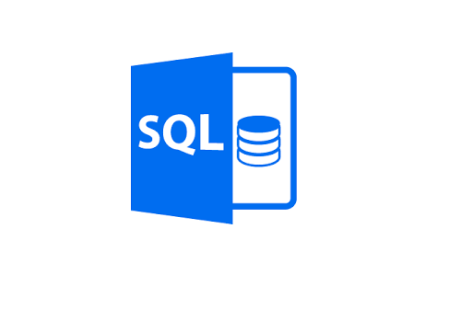
SQL Functions With Hands-on

Slide 2
Agenda
01
04
Introduction to SQL Functions
Hands-on on System Defined Functions
02
Types of Functions
05
User Defined Functions
03
06
Hands-on on User Defined Functions
System Defined Functions

Slide 3
Introduction to SQL
Functions

Slide 4
Introduction to SQL Functions
Functions are methods used to perform Data Operations.
Function in SQL server are the database objects that contains a set of SQL statements to perform a specific task.
A function accepts input parameters, perform actions and then return the result.

Slide 5
Types of Functions

Slide 6
Types of Functions
System Defined Functions(Inbuilt Functions)
User Defined Functions(Scalar Functions)

Slide 7
System Defined Functions

Slide 8
System Defined Functions
System Defined Functions are already defined in the system.
This functions are also called as Inbuilt functions.
Usage of Inbuilt functions save much development time while
performing certain tasks.
Types
Aggregate Functions (SUM(),AVG(),MIN(),MAX(),COUNT(),FIRST(),LAST()).
String Functions (TRIM(),CONCAT(),SUBSTRING(),LEN(),LTRIM(),RTRIM(),UPPER(),LOWER()).
Date Functions (GETDATE(),DAY(),MONTH(),YEAR(),DATEADD()).
Advanced Functions (IIF(),CAST(),CONVERT(),ISNUMERIC()).

Slide 9
HANDS-ON

Slide 10
User Defined Function.

Slide 11
User Defined Functions
User defined function are functions that are developed by user.
It will allow programmer to create their own routine and procedure that the computer can follow.
UDFs are crested by user as per his own requirements to perform complex operation.
Types
Scalar Functions
Table Valued Functions

Slide 12
HANDS-ON

Slide 13

India: +91-7847955955
US: 1-800-216-8930 (TOLL FREE)
support@intellipaat.com
24/7 Chat with Our Course Advisor
Notes:
Thank you!

